Slide 1
Upcoming Due dates
Co-op Action Plan – Final
Due – March 28 (online), in class March 29 (hard copy). Failure to provide in class copy -10%
Final Test - covers everything from week 1 - 9
In class Thursday, April 12 2018
Notes:
Change to include correct dates

Slide 2
CO-OP WORK TERM Action Plan
Work Term Goal (End Point)
What is your ideal position for your work term? Where do you want to be (think industry, job title, skills/abilities) and why?.
Goals and Objectives
How will you achieve your end point?
SMART goals – ensure they are specific/measurable/timestamped
Each SMART goal has 3 SMART objectives
Strategic Plan – visual timeline
Map out your SMART goals and SMART objectives on a visual timeline (See Week # 2 PowerPoint)
Implementation Plan
How/when and who will keep you accountable
FOLLOW ASSIGNMENT INSTRUCTIONS!
*See Moodle ^

Slide 3
Option 1: In – Class Activities
In Groups:
Make the following into a S.M.A.R.T Goal and create a S.M.A.R.T objective:
Saving money
Notes:
Have a few groups write answers on board and take up together (maybe one poor example / one good example)

Slide 4
Option 2: In-Class Activity
Networking Activity:
BINGO
You have 2 minutes to fill out as many boxes as you can with signatures. Each person can only sign ONCE on each sheet!
Notes:
After the 2 minutes student submit their sheets; instructor will choose 3 sheets that had the most signatures – instructor will then choose one of the boxes for each student and ask each student to name the person who signed that box or vice versa. The activity is supposed to show that students should be communicating with each other, not just asking for signatures (ex: not just asking about jobs) or getting as many connections on LinkedIn without communicating

Slide 5
Why Volunteer?
Why NOT Volunteer?
Notes:
Discuss reasons for both

Slide 6
Local Volunteering Opportunities
http://www.volunteertoronto.ca
http://www1.toronto.ca/
https://workinnonprofits.ca/index.py?sel=f
http://charityvillage.com
*And many more!

Slide 7
The Purpose of Networking
Is NOT about connecting with the masses but it IS about building and maintaining authentic mutually beneficial relationships.

Slide 8
"Networking is about doing what your mother told you to never do . . . talk to strangers. It's like playing host at someone else's party. At a real level, it's about learning about other people and finding the links that you have with them."
https://lambton.optimalresume.com/

Slide 9
Examples of Networking Opportunities
Local events
Volunteering
Informational Interviews
Professional Associations/Groups
Networking events
Job Fairs/Career fairs

Slide 10
Local Networking Groups
Young Professionals Network of Ontario
http://www.ypnontario.com/
The Hip Haus * excellent networking events!
http://thehiphaus.com/about-us/
Eventbrite – List of Networking Events in TO https://www.eventbrite.ca/d/canada--toronto/networking/
10 Thousand Coffees
https://www.tenthousandcoffees.com/
https://twitter.com/10kcoffees?lang=en
Meetup.com – Lots of Networking Events!
https://www.meetup.com/topics/professional-networking/

Slide 11
Local Networking Groups Cont…
MaRS – Events and Community Job Board!
https://marsdd.com/events/
Startup North – Start Up Companies
http://startupnorth.ca/
…and more! Do some research re: upcoming events or fests in and around Toronto!

Slide 12
How to Introduce Yourself
Start conversation by introducing yourself and shaking hands:
Ask questions such as: what brought you to this event? Have you been to this event before? Etc.
Get to know the person: where are they from, what company do they work for, position, etc.
Always ask for business card
Send follow up email/LinkedIn connection re: meeting at event. Keep it brief but continue conversation; good time to request an informational interview!
What not to do:
Introduce yourself by saying “I am looking for a co-op”
Immediately asking if they have a position available
Resources: https://www.forbes.com/sites/elanagross/2016/05/30/the-best-questions-to-ask-at-networking-events/#484e206d802a
https://www.cpacanada.ca/en/connecting-and-news/blogs/leadership-innovation/five-questions-to-ask-when-networking

Slide 13
Informational Interviews Cont.…
Remember: An informational interview is an interview conducted to collect information about a job, career field, industry or company.
http://www.quintcareers.com/informational_interviewing.html

Slide 14
Job Fair Etiquette
Register for the event in advance
Come prepared to interview: prepare interview answers, attire and a positive attitude!
Do not approach employers with friends or family!!! (Employers like to see independent and mature candidates)
Show the employers you are interested!
Collect business cards and contact information – follow up with employers
Plan to spend time at the booths and ask the employers questions!

Slide 15
Professional Conference
Who will be there?
Managers, Supervisors, HR Managers, Recruiters, current staff members
Employees, Job Seekers
What to prepare?
Business/ Networking Cards – linkedinprofile link
Be prepared to sell yourself!

Slide 16
Career Fair/ Job Fair
Who will be there?
Managers, Supervisors, HR Managers, Recruiters, current staff members, etc.
What to prepare?
Many copies of your resume, basic interview answers
Be prepared to sell yourself!

Slide 17
Co-op Fair
Who will be there?
Managers, Supervisors, HR Managers, Recruiters, current staff members, etc.
What to prepare?
Introduction/ Elevator Speech
Many copies of your resume, basic interview answers
Transcript
Be prepared to sell yourself!

Slide 18
Orientation Week
Who will be there?
Instructors, Advisors, Dean, School Directors
What to prepare?
Introduction, questions, request for contact information/location
Be prepared to sell yourself!

Slide 19
Networking Online
Discussion boards
Online Networking
LinkedIn
Twitter
Facebook
Professional Associations Sites
Blogs

Slide 20
PROFESSIONAL
Online Presence
V.S
SOCIAL
Online Presence
** http://www.forbes.com/sites/danschawbel/2011/02/21/5-reasons-why-your-online-presence-will-replace-your-resume-in-10-years/

Slide 21
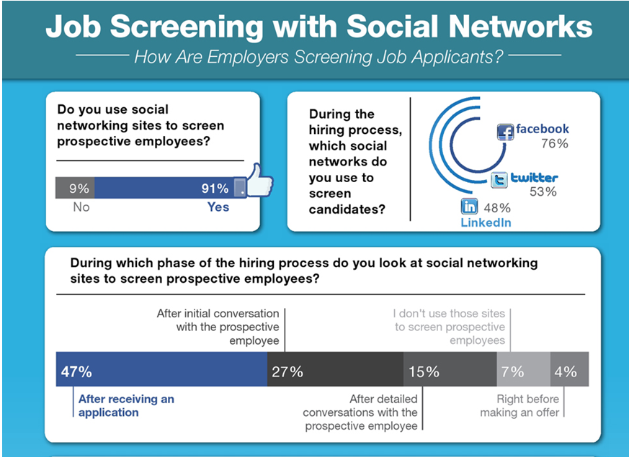

Slide 22
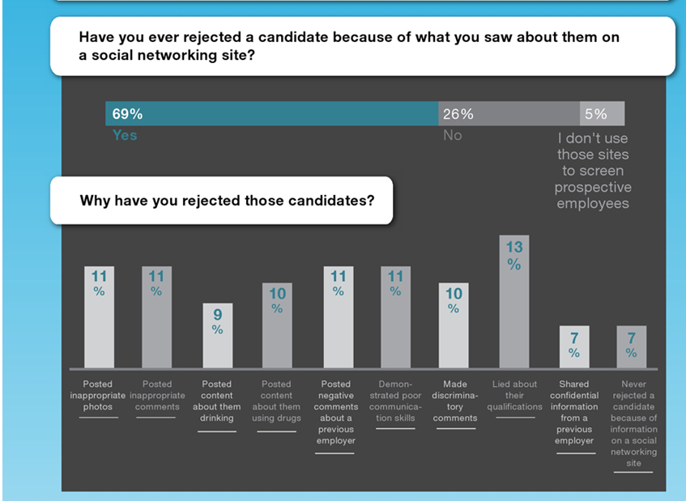

Slide 23
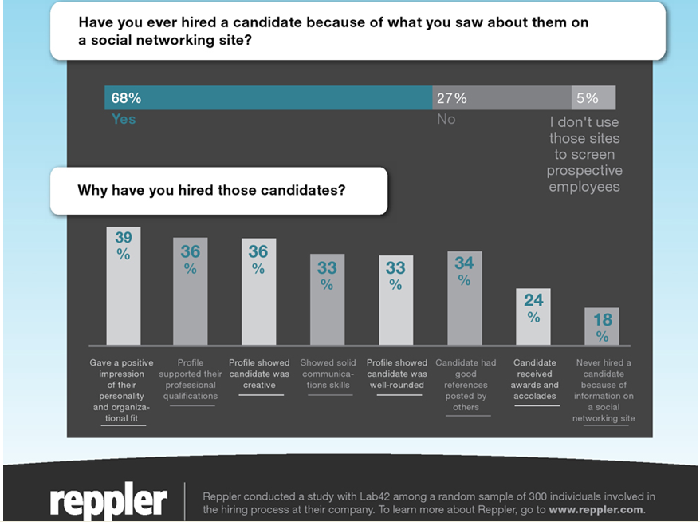

Slide 24
Google
Yourself
What comes up first? What pictures do you see? Articles?
Notes:
Instructors: this is optional dependant on time!!!

Slide 25
Employers don’t usually search with the hopes of finding something negative about you. The opposite is true- they’re looking to confirm the information on your resume and hoping to find more proof that you’re a good candidate who really can help their company. However, employers can’t predict how their search will end, only you can control this.

Slide 26
Social Media Sites
How to manage your social media privacy settings:
https://identity.utexas.edu/everyone/how-to-manage-your-social-media-privacy-settings
Facebook
Pictures: watch what you post and what others post of you
Privatize your account for only your friends/family if you are not using this site for job search
Twitter – Professional Account
Start by following the companies and individuals (hiring managers and recruiters) that interest you, as well as some of their followers
Next, get familiar with the content they are talking about. After all, reading will build your knowledge about the market and its players.

Slide 27
Linkedin
The worlds largest professional network
400 million people
7 million Canadian professionals on LinkedIn
https://www.linkedin.com/static?key=what_is_linkedin

Slide 28
How to Build a LinkedIn Profile
How to Make a Great LinkedIn Profile - 6 LinkedIn Profile Tips
https://www.youtube.com/watch?v=27BTcka64wQ
Using LinkedIn to find a job: top five tips
https://www.youtube.com/watch?v=mselUcO8KoI
*Many other YouTube videos can be found, including LinkedIn tutorials found on their website

Slide 29
Ways to Optimize your LinkedIn Profile
Professional photo – ensure it is visible to public – NO selfies
Headline – MUST have – be unique or use job title
Know your general audience but be careful not to target a specific position
Know your key words; what words would employers use for a search?
Distinguish your profile from your résumé yet be consistent
Don’t exaggerate – do substantiate (prove it!)
Keep your profile up-to-date
Notes:
Photos – recent, engaging, smiling, eye contact
No photo – begs the question – what are you hiding?
Okay folks, I’m going to give it to you straight: There are certain phrases when used in a LinkedIn summary that have the same effect as nails on a chalkboard.
In other words, it’s such a turn-off as a hiring manager, it’s hard to focus on your profile as being credible after reading them. This is the profile summary someone asked me to review. I’ve underlined the phrases that make me want to cover my ears and run from my computer screen yelling, “NOOOOO. Not again!”
A dynamic leader with the ability to drive change and proven track record of high accomplishments in various areas. Highly organized individual, believes in empowerment and team work, highly adaptable, strong business sense, effective communicator, result-oriented, and can-do attitude.
What makes me cringe when I read this?
For starters, the person is being completely subjective. These aren’t facts about them (facts are backed by numbers and statistics). This summary is the person’s opinion of themselves – and it comes across as over-confident and canned. Honestly, it’s the worst use of a LinkedIn summary you can possible implement… especially during a job search.
If you are looking for a job in 2012, I am begging you not to ruin your profile with an unsubstantiated, over-used summary statement like this one.
What should be there instead?
Facts, facts, and more facts. Tell me about your accomplishments in as few words as possible, using numbers and statistics to support the truth. An example might be:
15+ years of experience leading teams of 10-200 staff members. Managed 30+ projects ranging from $100K-$1.7M in budget. 200+ hours of presenting and training on a wide variety of subjects including innovation, teamwork and project management.
See the difference?
In the original summary, the person is claiming to be all those things. In the revised summary they are proving it.
When it comes to your LinkedIn summary, remember you need to compel the reader to scroll down the page and look at your work history. These days, bragging won’t make that happen. Stating facts that entice them to see where you accomplished them will.
Careerrealism.com

Slide 30
Profile at 100% complete
Be sure to include the following:
Your industry and location
Your current position, including a description
Two previous positions (with descriptions!)
Education (all post-secondary education)
Skills (minimum of 3)
Try to reach a minimum of 50 connections
Have two pieces of information for every section on LinkedIn. Example: Interests, Groups, Projects, Experience.
https://www.linkedin.com/pulse/10-tips-students-new-grads-linkedin-omar-garriott
Notes:
Place the cursor over the circle graph to see how you could improve/add to your profile
If it is at 100% complete there will be an option to share your profile on Facebook and Twitter

Slide 31
How To Use LinkedIn To Network
These are two articles on how to reach out via LinkedIn: remember, it isn’t about asking for a co-op; Networking is about building a relationship:
https://www.linkedin.com/pulse/took-four-sentences-land-my-dream-internship-linkedin-andrea-lowitz/
https://www.themuse.com/advice/how-a-simple-linkedin-message-that-took-2-minutes-to-write-landed-me-my-dream-job

Slide 32
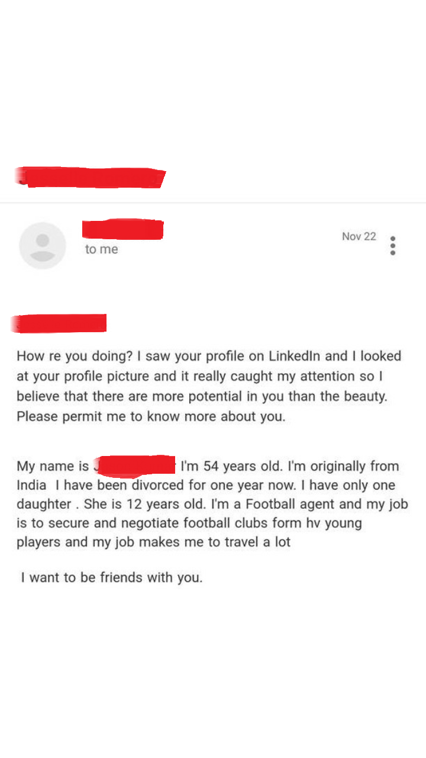
Poor Example: LinkedIn Message

Slide 33
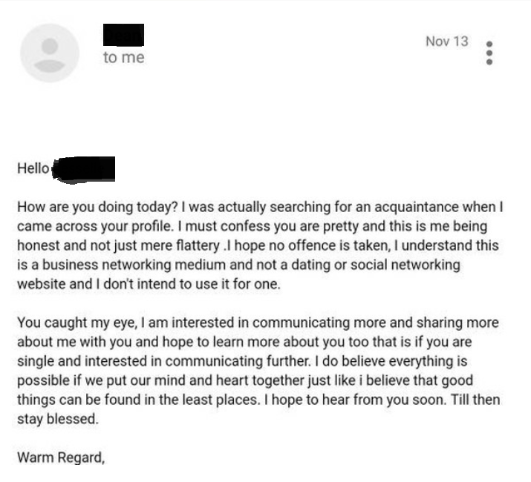
Poor Example 2: LinkedIn Message

Slide 34
Good Example: LinkedIn Message for Informational Interview
Hi Sheena,
For the last few months I have been following Lambton College and all of the great initiatives the school has been taking to engage the community.
I thought it would be a good opportunity to connect with you and gain more insight. I know this is a busy time of year, but if you have 15 minutes to spare, I would love to set up a call or meet for a coffee.
Looking forward to potentially connecting!
Thank you,
Alexandra Richardson

Slide 35
Good Example: Asking About Potential Internships/ Co-op
“Hi Yumi,
My name is Andrea and I am a fellow Lambton College alumni. I saw your profile and wanted to reach out to you as I am really interested in interning at LinkedIn this summer. I was wondering if you could give me advice for landing an internship there! I would love to get to know you and the internship program.
Thank you!
Andrea”
Source: https://www.linkedin.com/pulse/took-four-sentences-land-my-dream-internship-linkedin-andrea-lowitz/

Slide 36
Week #7 – Online Work
Professional Online Presence
Read - http://www.eofire.com/7-ways-to-build-your online-presence/
Why do this?
Read - http://theundercoverrecruiter.com/7-ways-college-students-can-benefit-linkedin/
Build Your Platform: Review the following resources:
https://university.linkedin.com/content/dam/university/global/en_US/site/pdf/LinkedIn%20Profile%20Checklist%20-%20College%20Students.pdf
https://university.linkedin.com/content/dam/university/global/en_US/site/pdf/TipSheet_BuildingaGreatProfile.pdf
Submit: Create a LinkedIn Profile :
Looking for professional Photo, Education, and Work Experience with short descriptions.
Include Screenshot of your profile and a direct Link (that works) for me to follow and view your profile – NO PDF

